Slide 1


Project Proposal
First Option : Stocks Prediction
Workshop in Data Science
Team 003 - Itay Mutzafi, Moran Zaks , Shaked Schnarch
Notes:
Moran
Good afternoon. We are Itay Mutzafi, Moran Zaks, and Shaked Schnarch
Our first option is in the financial markets: Stocks Prediction. The task is a Supervised Binary Classification on noisy time-series data.
Our second option is in Neuroscience: Detecting Autism Patterns in Brain Signals.
We will now dive into the first option: Stocks Prediction.

Slide 2
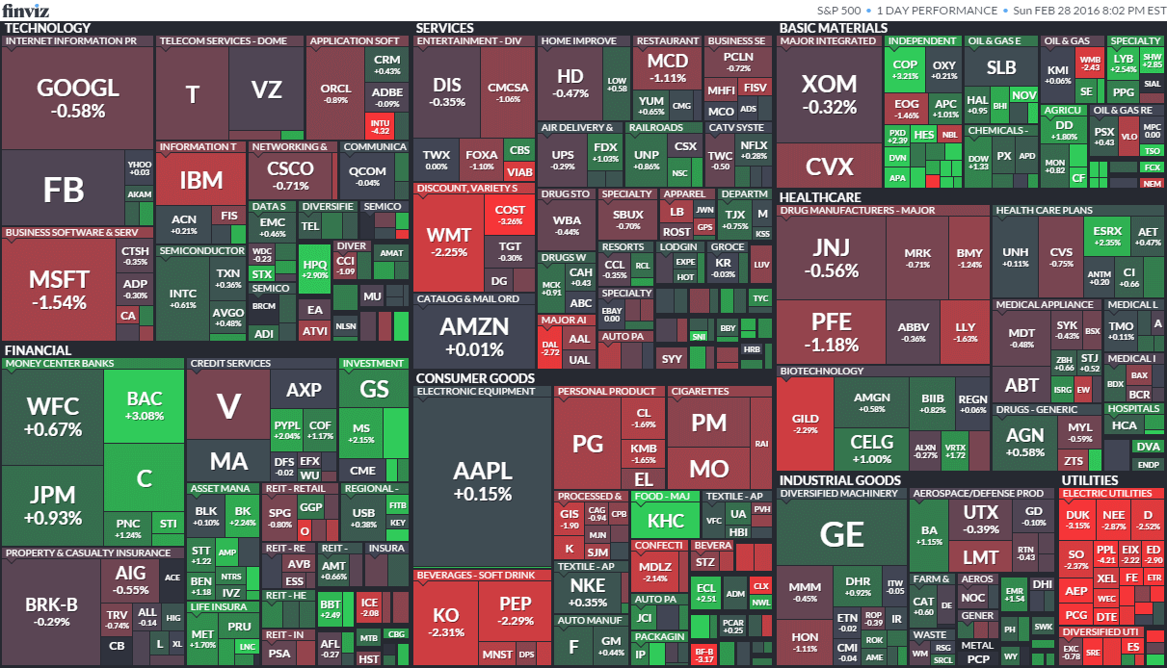
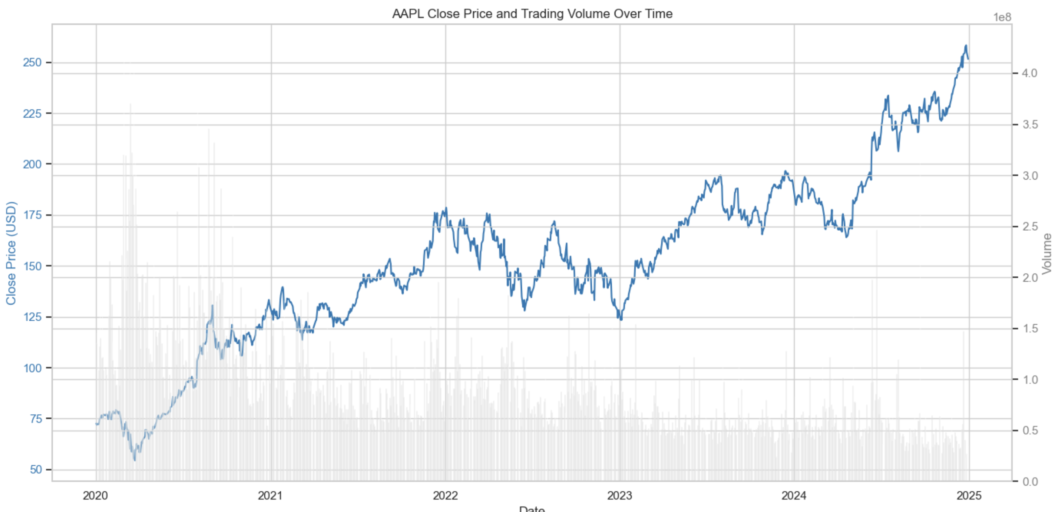
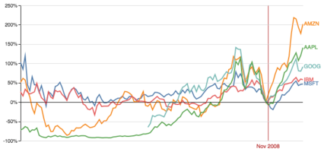

Background & Topic
Motivation for this task
Short-term decision making in trading
Evaluating ML performance on noisy time-series data
The Task
Binary Classification based on the past data, predict if Apple’s stock will increase or decrease in the future .
Main dataset
Yahoo Finance’s API- Apple’s Stock
Additional dataset
Other Stocks
Additional dataset
Google News
Notes:
Moran
Our idea is to use public financial dataset to answer the question based on the past trading days and the new will a stock increase or decrease tommorow? We still need to dive in and check the time frames for the input and output
We will compare our resoults between training over
only the specific stock’s past
other companies in the market’s change
news titles like ‘new iphone is coming out
motivation is both trading decisions for investors etc., and for evaluating ML over noisy time-series data

Slide 3
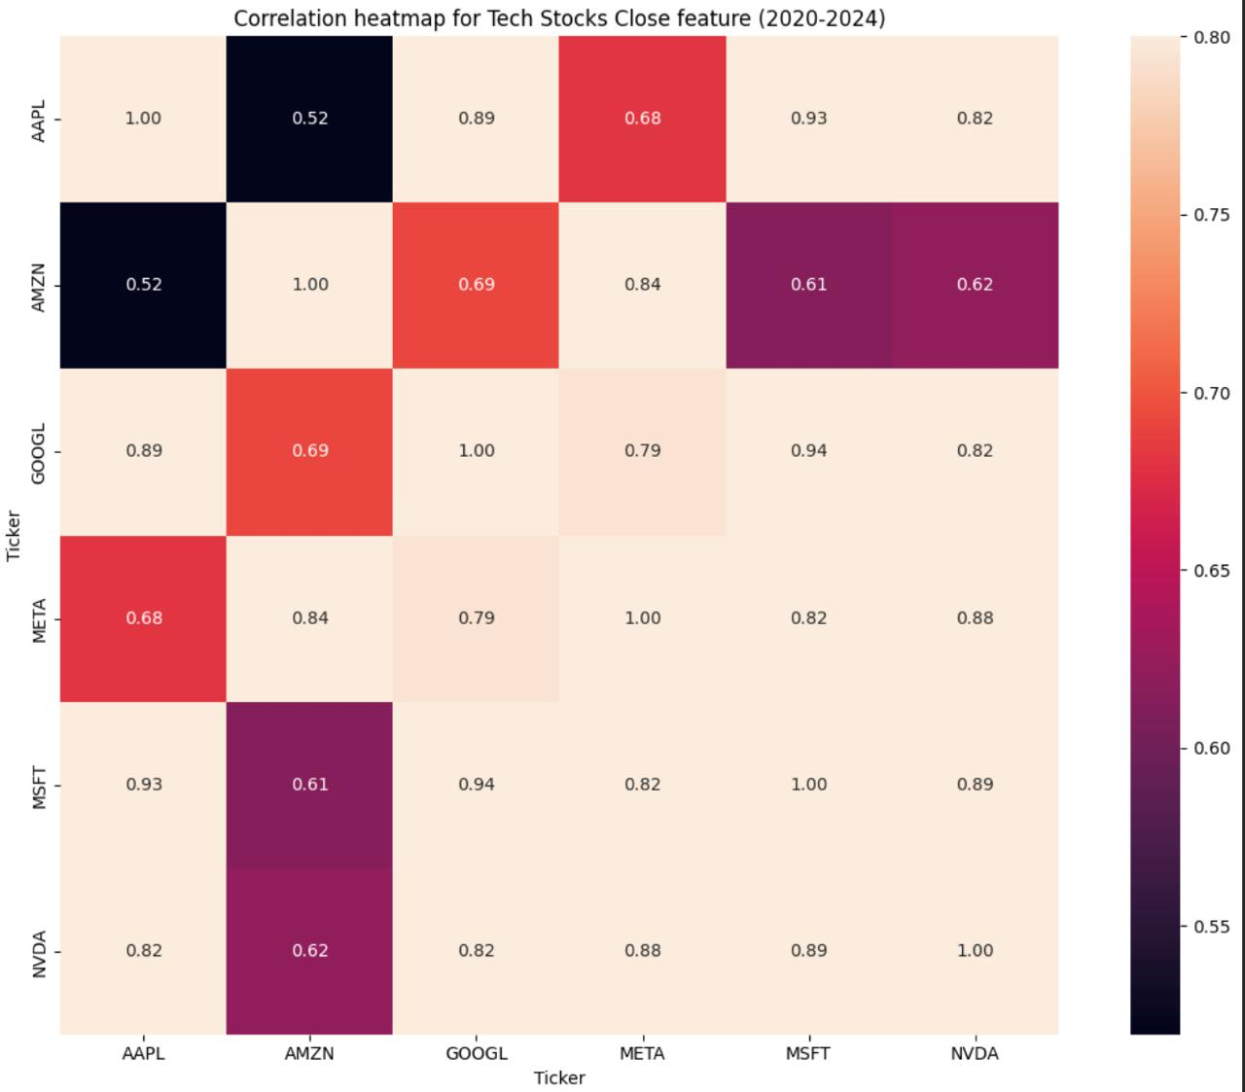
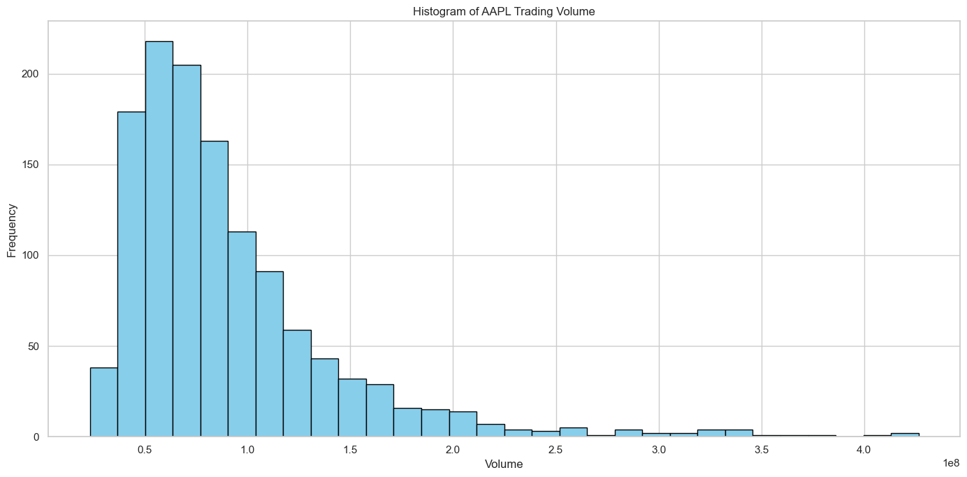
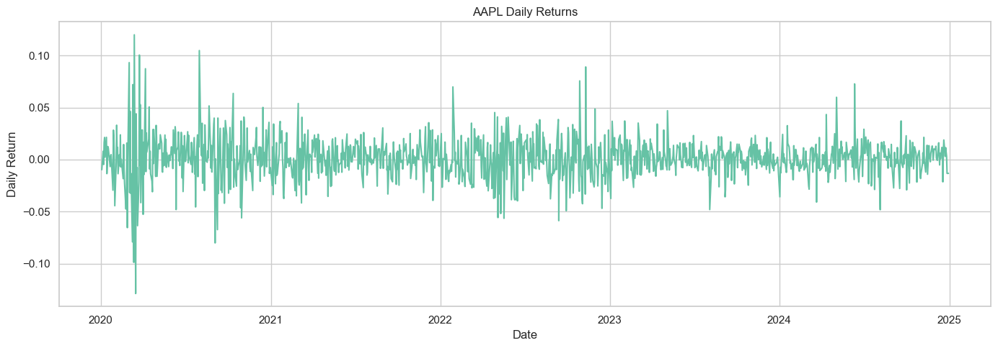
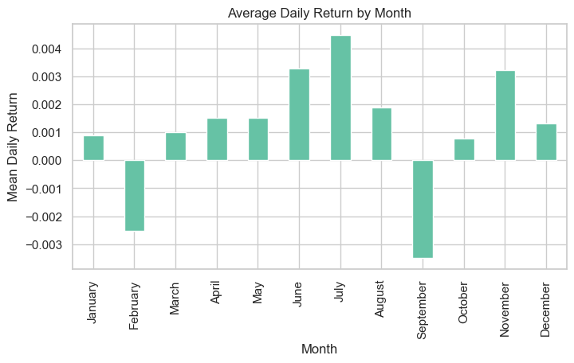
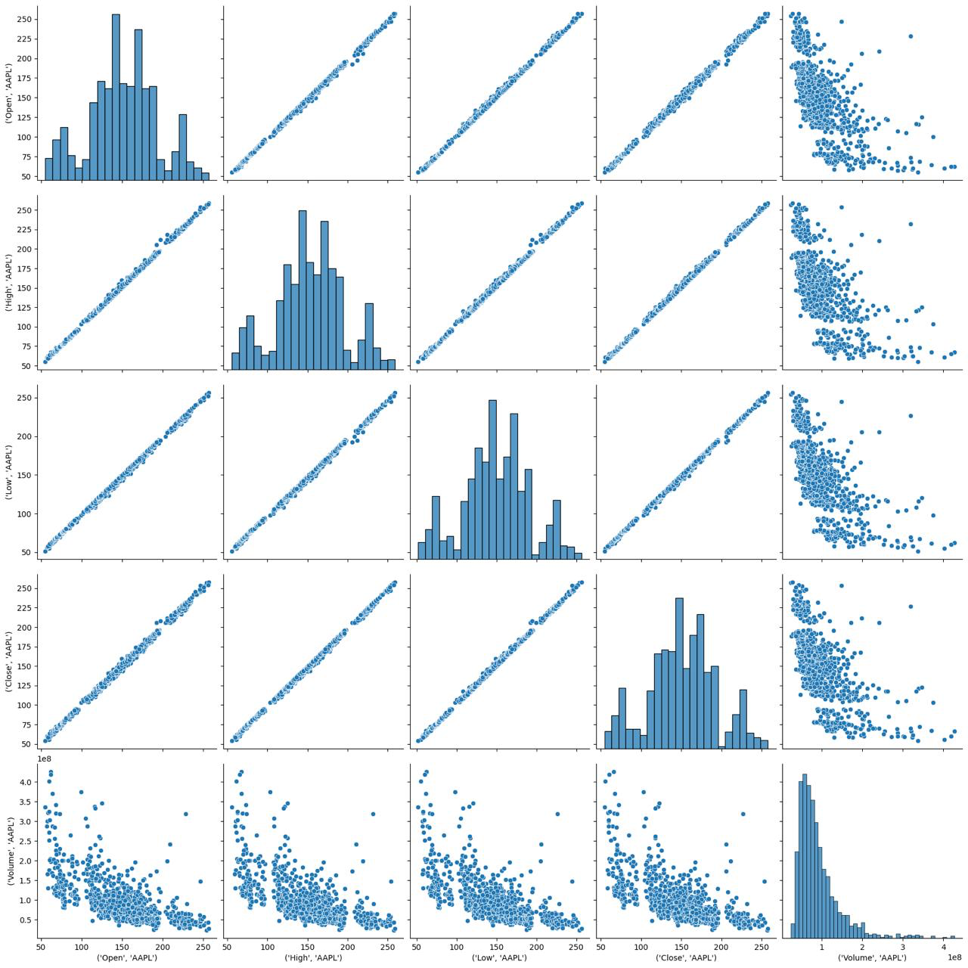
Feasibility Analysis
Initial Data Exploration
Total Samples: 1275 t.s. for each stock
Core Features: Open, Close, High, Low, Volume
Expected Challenges:
Feature Engineering - Daily return, Moving Average, Volatility etc.
Seasonality
News Sentiment Analysis
Why is this Feasible?
Classification and not exact price
Highly-documented data
Notes:
Moran
By starting to look at the data we see we have basic features and will need to do feature engineering for more like daily return
daily return - predicts the percentage change in stock price from one day to the next
moving average is the average of the last N days of prices
volatility - תנודתיות
We will need to address the seasonality of the data (Holidays, Options expiry day)
supporting dataset will add the titles from the news. Using NLP method for sentiment analysis.
We believe this is feasible since we only predict the change and not the exact price, and we have a lot data to train on

Slide 4

Methodology
Project Work Plan
Data exploration
Feature Selection
Feature engineering
1 week for financial and 1 for news
Evaluation
Debugging
Final Presentation
Submission!
16.12 - 5.1
26.10 - 24.11
24.11 - 8.12
9.12 - 15.12
6.1 - 20.1
Business Understanding
Data Preparation
Model Selection
Finishers
Find potential subjects
Choose one subject
Class first checkpoint
Model selection
Class checkpoint
Success Criteria
Accuracy prediction- 55%–60%
Feature engineering- features improve the model and have a meaning
⁠Stability Over Time- across different years
Notes:
Itay

Slide 5

Second Option :
Detecting Autism Patterns in Brain Signals
Beyond Static Averages: Quantifying Temporal Dynamics in Calcium Imaging
Notes:
Shaked
Now, we will move on to our second project option.
While the first option dealt with financial markets, this project focuses on Neuroscience.
Here, we aim to use Time-Series Classification to distinguish between healthy brain cells and those carrying an Autism-related mutation.

Slide 6
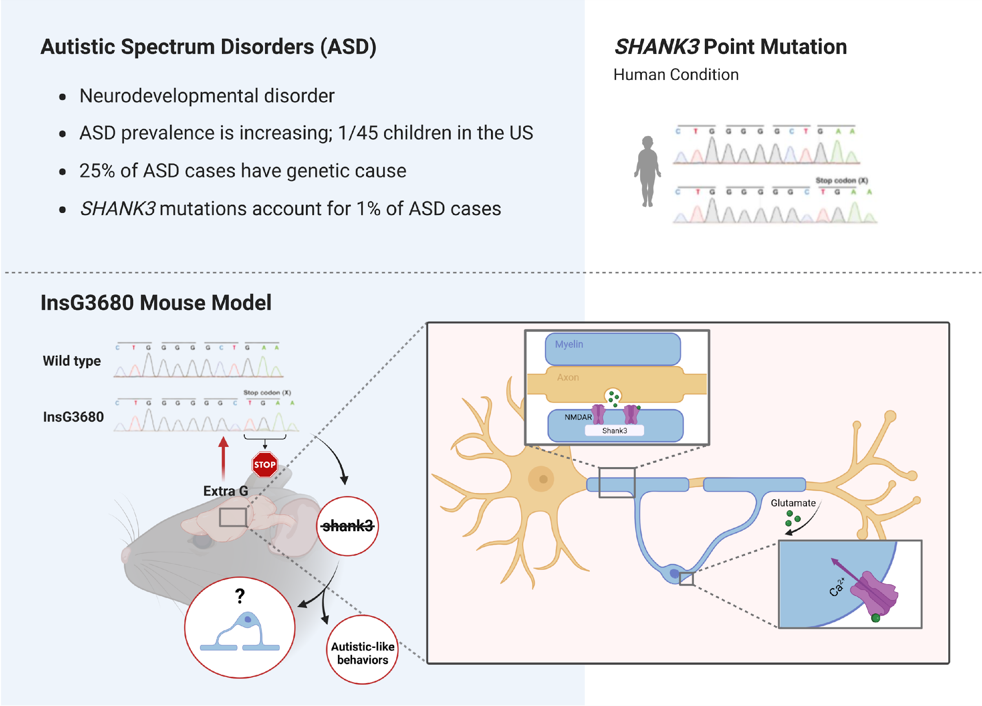
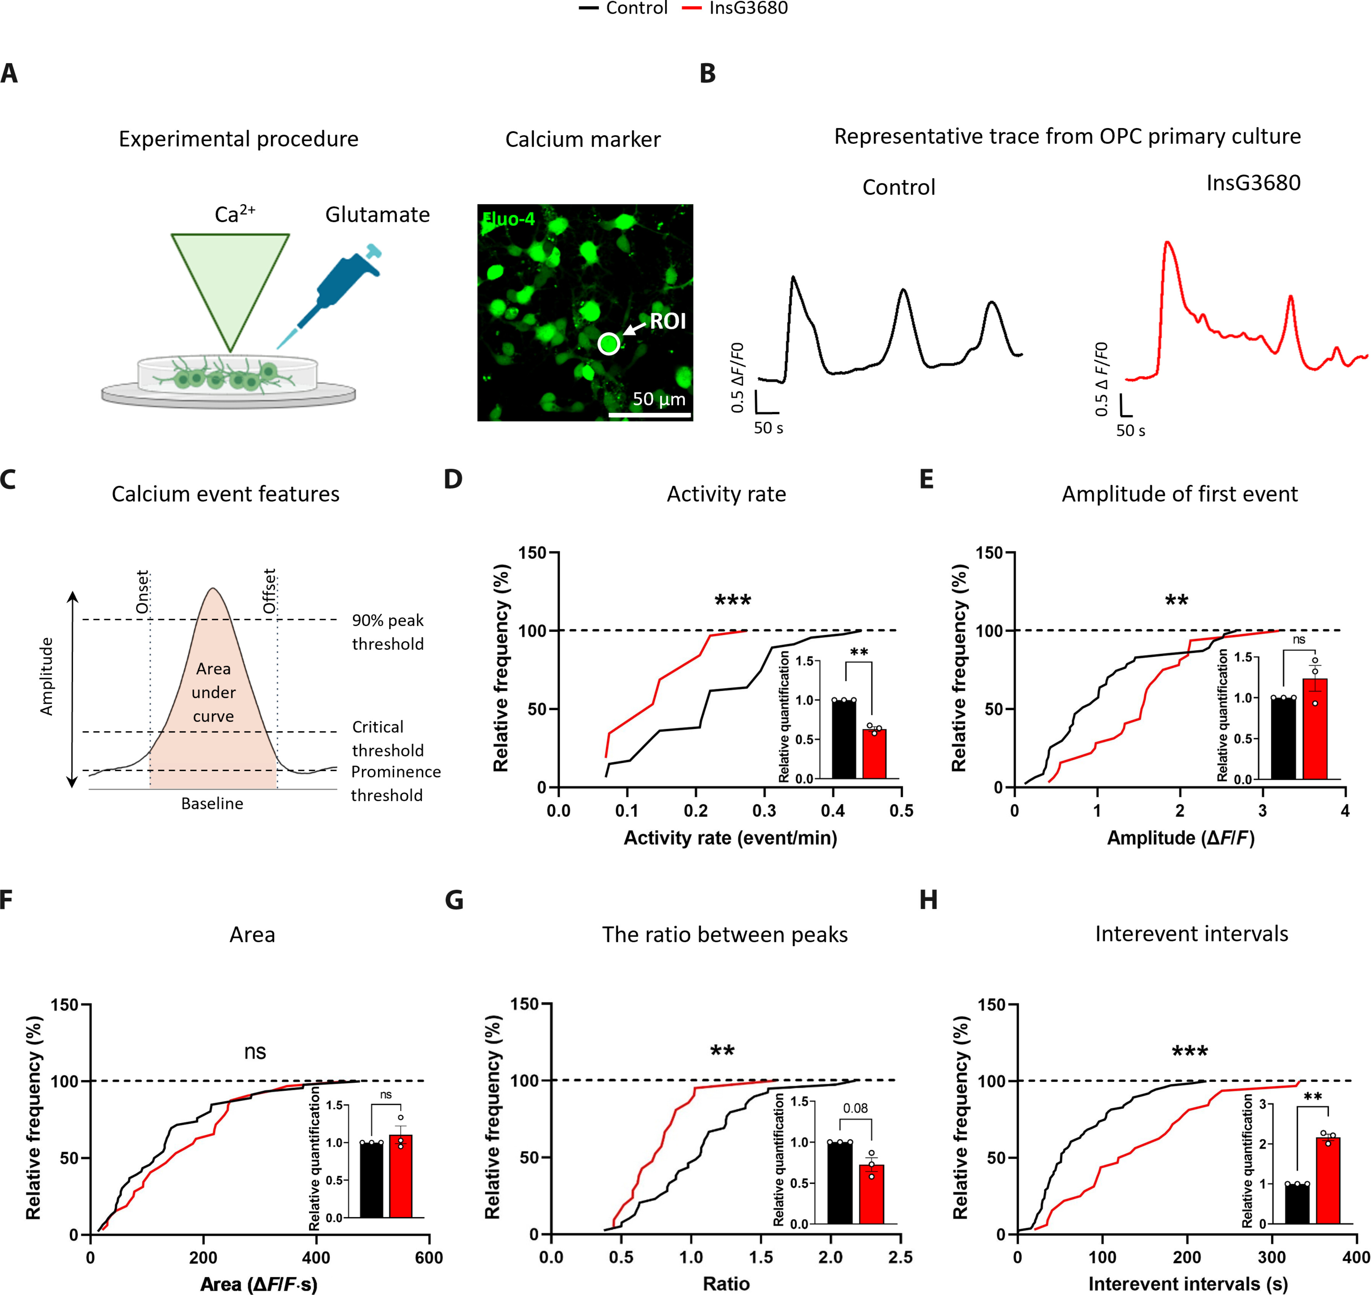

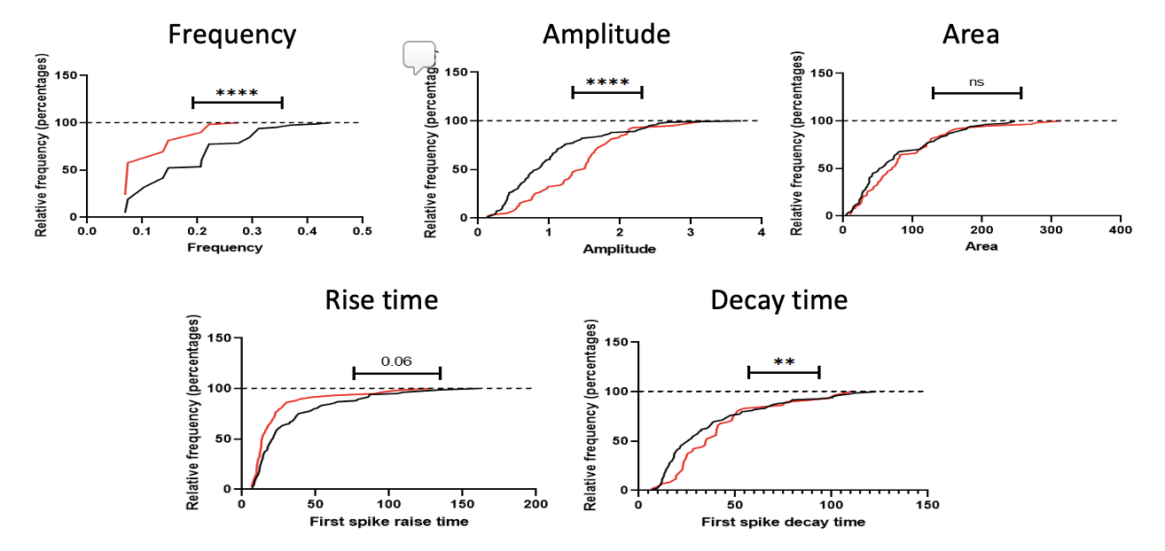
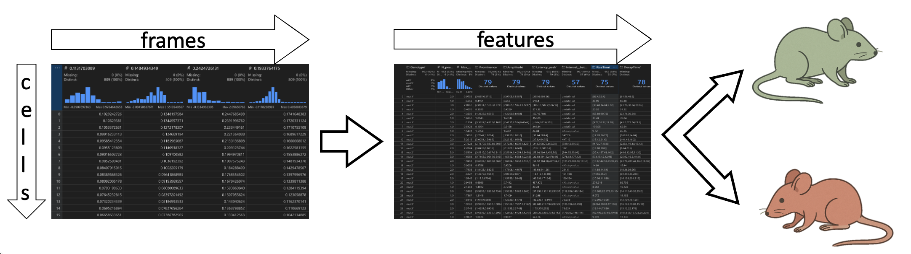
Background & Topic
The Biological Problem
Context: Shank3 mutation cause Autism.
Discovery: Recent reveals this mutation affects OPC cells.
The Phenomenon: Mutant cells exhibit a "Fading Phenotype"
The Task
Supervised Binary Classification: Predict WT vs. Mutant .
Source
Boaz Barak’s Lab
Data Type
Time-Series (Calcium Traces)
Dimensions
810 Frames (15 min) x 1000 ROIs
The Baseline
Existing analysis: relies on static averages
The Current Limitation: High information loss.
Notes:
Shaked
The Biological Problem is that a genetic mutation called Shank3 causes specific brain cells (OPCs) to exhibit what we call the 'Fading Phenotype.’
If you look at the graphs on the right, the Control cell (black) shows stable activity, but the Mutant cell (red) starts strong and then collapses.
Here is the Data Science Gap: The existing analysis, the baseline, relies only on static averages. This is a major limitation because a 'crashed' signal and a 'stable' signal can have the exact same average, leading to significant Information Loss.
Our Task is Supervised Binary Classification: we need to predict if a cell is 'Wild Type' (Healthy) or 'Mutant’. We aim to capture the temporal shape—the actual dynamics of the signal—rather than just its static average"

Slide 7
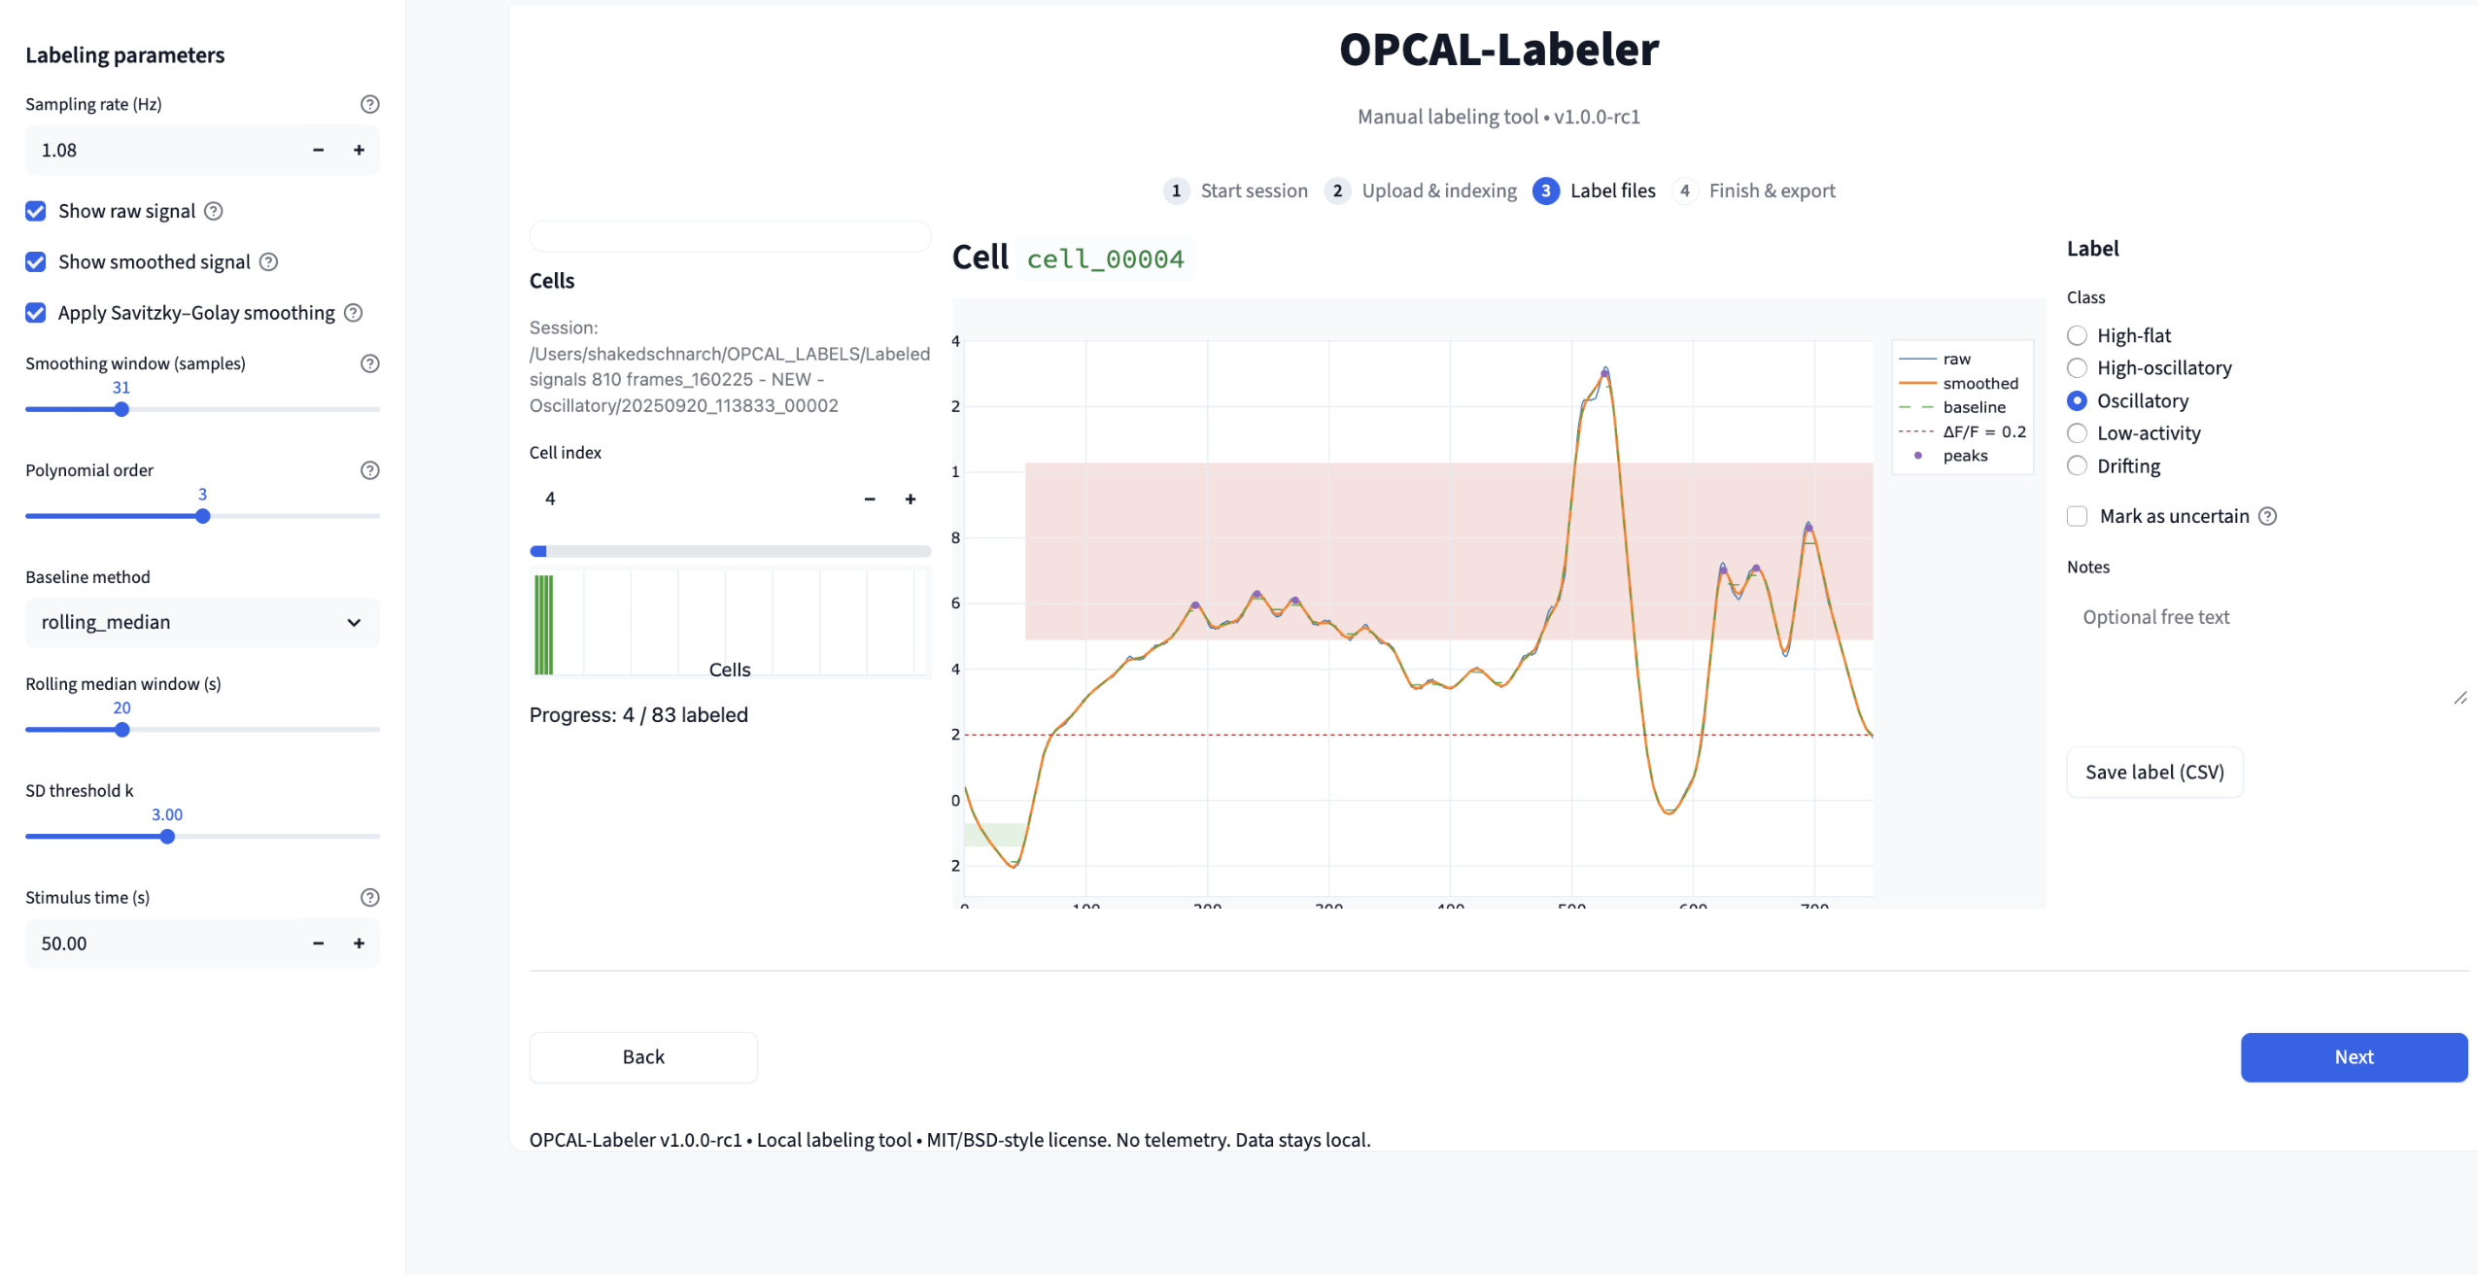
Feasibility Analysis
Legacy CSVs
New Recordings
Cleaning & ID Mapping
Unified Dataset
Curation Pipeline:
Initial Data Exploration
Total Samples (ROIs): N = 4,600
Time Series Length: 810 frames (15 mins) @ 1.1s interval.
Key Event: Glutamate Injection at frame ~102.
Our DS Innovation: Temporal Feature Engineering
Proposed Features: Decay Slope (rate of decline), Early-vs-Late activity ratio, Stability across time.
Group-level split by animal to prevent data leakage.
Why is this Feasible?
Scientific Validity: The "Fading" effect is a documented biological mechanism.
Baseline Evidence: Baseline showed that even simple achieve partial separation.
Notes:
Shaked
Our Hypothesis is that by using Machine Learning to capture the rate of decay and stability over time, we can significantly outperform the current baseline methods
Why is this project feasible? First, the data is real and biologically validated. The 'Fading' effect is not random noise; it is a documented mechanism. Second, even simple manual analysis in the past showed some separation.

Slide 8
Methodology
Project Work Plan
Metrics
interpretability
Evaluation
Combine the data
Standardize
Map each ROI to ID
EDA
Debugging
Final Presentation
Submission!
16.12 - 5.1
26.10 - 24.11
24.11 - 8.12
9.12 - 15.12
6.1 - 20.1
Business Understanding
Data Preparation
Model Selection
Finishers
Extract interpretable temporal descriptors
Group-based test & split.
Model selection
Class checkpoint
Train baseline models using static features.
Train temporal-feature models (comparison).
Success Criteria
Quantitative: Improvement over the static baseline.
Better generalization across animals in group-based test splits.
Qualitative: Identification of new temporal features that capture the fading signature.
Notes:
Itay
Our methodology follows a standard and realistic DS pipeline.
Success for us means three things:
Quantitatively, showing clear improvement over the static baseline.
Qualitatively, identifying temporal features that reflect the fading pattern.
Comparatively, reproducing the original analysis and demonstrating what additional information our temporal features capture.

Slide 9


Stocks vs. Brain Signals
Stocks
Excellent documentation and reliable API
Include data integration between two data sources
Feasible and intuitive
Hard to achieve strong results
Complex feature engineering
Train-test split
Brain Signals
Clear and well-justified scientific value
Highly feasible classification task
Chance of clear and strong results
Domain-specific challenge
Hard to visualize for general audience
Train-test split
Preference: focus on stocks
Notes:
Itay

